Slide 1
Quartus and VHDL Tutorial
Nihar Shah
Abhinav Sridhar

Slide 2
Plan of this Tutorial
Overview of Quartus and ModelSim
Programmable devices
Quartus
VHDL
Combinational logic
Testing using Force inputs
Sequential Logic
Automated testing using Testbench
Self Checking Testbench
Future scope of HDLs

Slide 3
Quartus And ModelSim

Slide 4
Quartus
Programmable logic device design software
Made by Altera
Previously known as Altera Quartus
After Intel acquired Altera now known as Intel Quartus.

Slide 5
ModelSim
Developed by Mentor Graphics
multi-language Support
VHDL, Verilog, SystemC
Can be used Independently
Or with Quartus, Xilinx ISE or Vivado

Slide 6
Programmable Devices

Slide 7
What is a programmable device?
Programmable device is an electronic component used in reconfigurable circuits.
Unlike ICs PLDs have reconfigurable logic gates.
Types:
FPGA: Field Programmable Gate Array
CPLD: Complex Programmable Logic Device
PLA: Programmable Logic Array
PAL: Programmable Array Logic
Others

Slide 8
Programmable devices
We have to implement the logic in a device before we can use it.
These devices can be erased many times.
Finite amount of resources inside.
Resources includes LUTs, Memories and many types of IO adaptors.

Slide 9
Implementation of an equation
A | B | Y
0 | 0 | 0
0 | 1 | 1
1 | 0 | 1
1 | 1 | 0

Slide 10
Which equation is this?

Slide 11
Quartus

Slide 12
Let’s start a project
** in MHTML file **

Slide 13
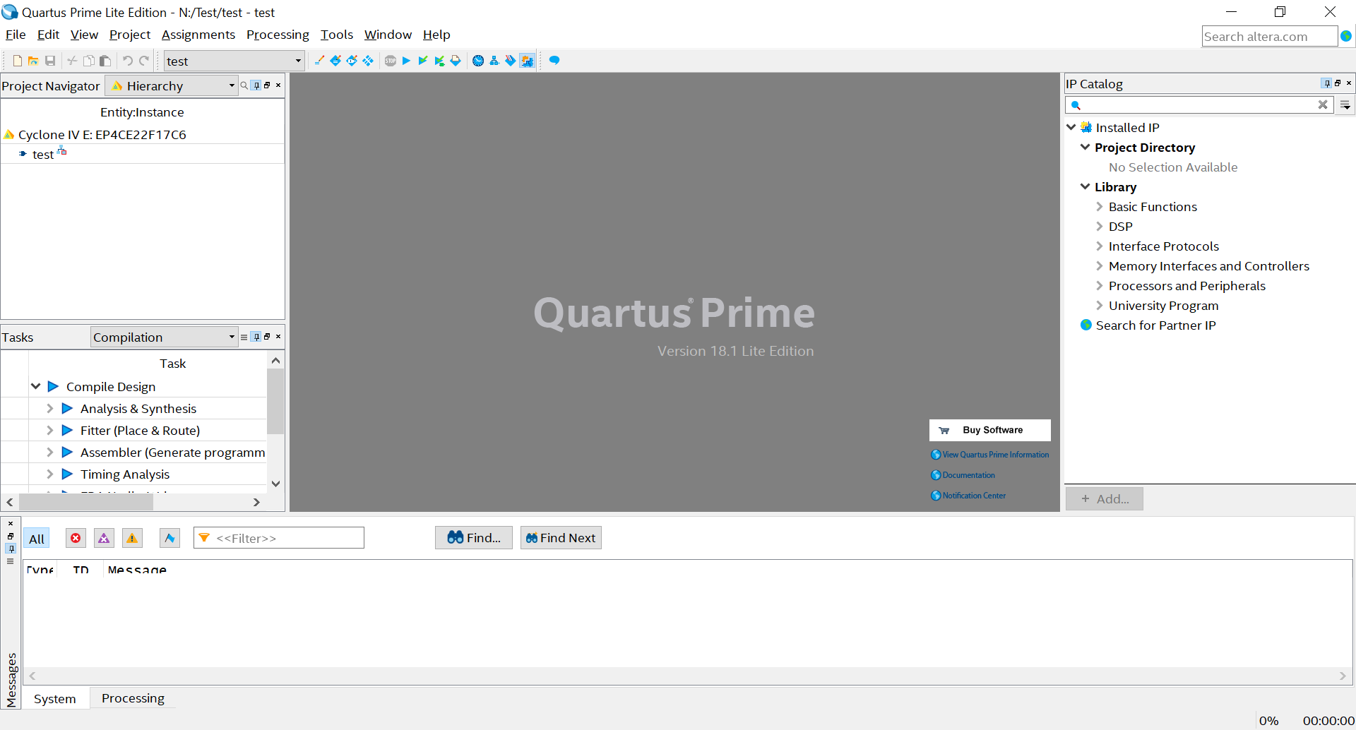

Slide 16
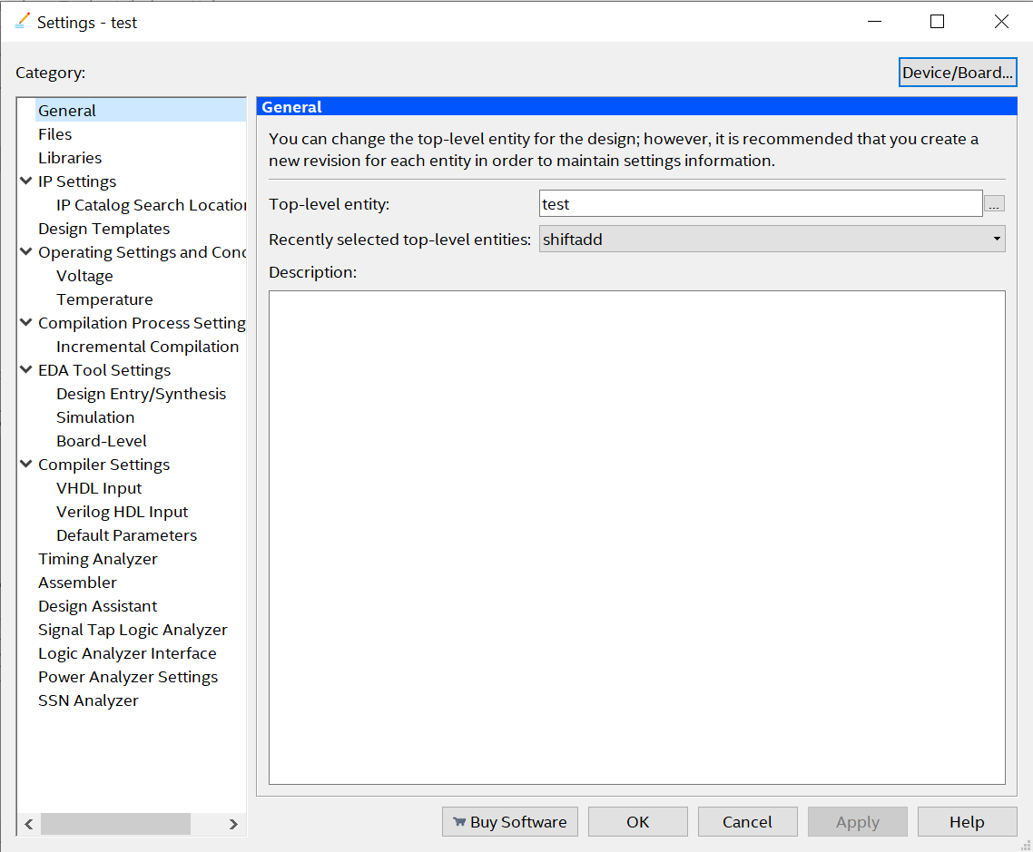
Top Level Entity

Slide 17
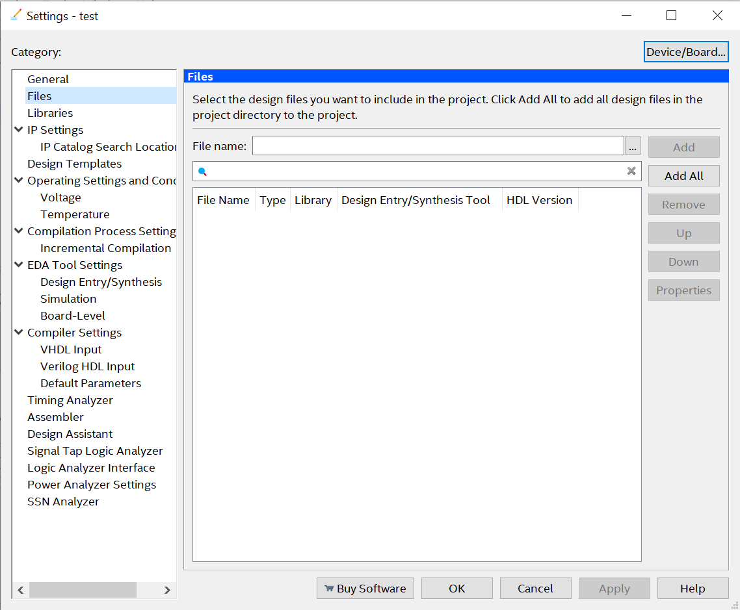
Files

Slide 18
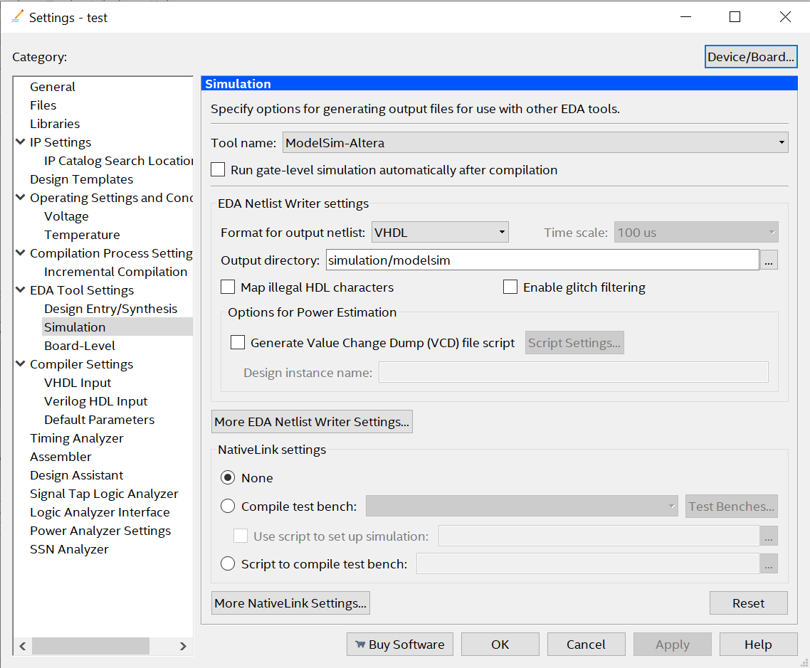

Slide 19
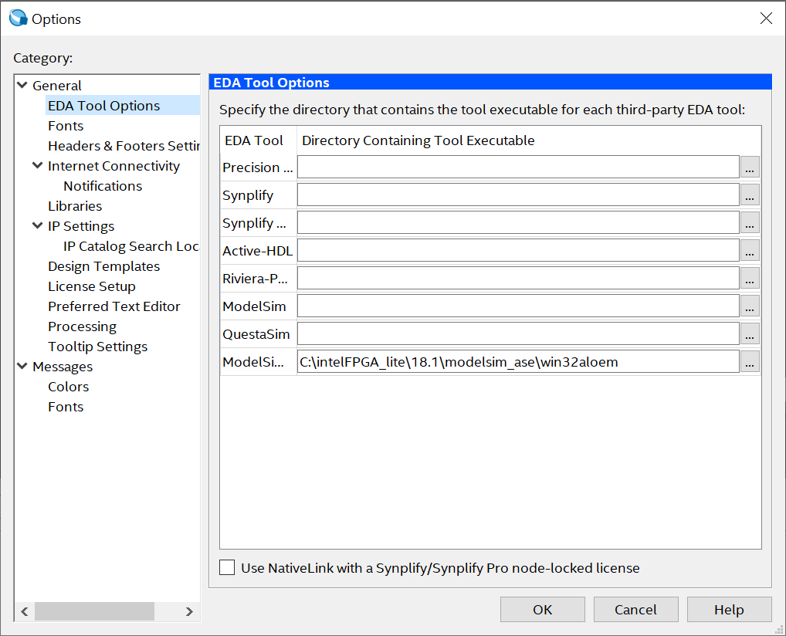
Tools > Options > EDA Tool Options

Slide 20
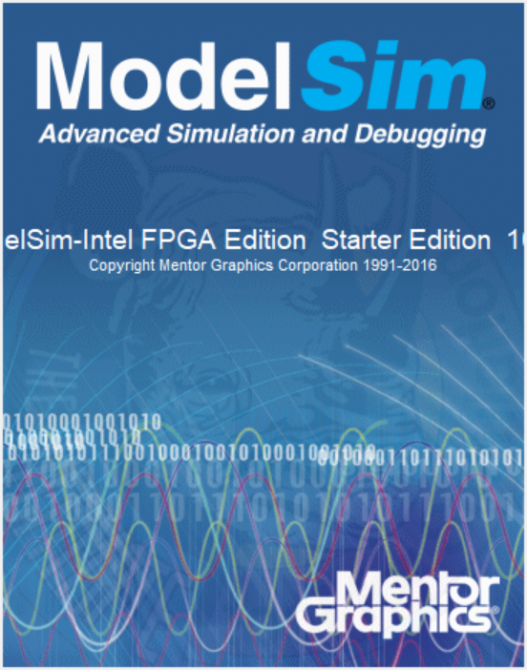

Slide 21
How to simulate
Navigate to path
Make work directory: vlib work
Compile file(s)
vcom filename.vhdl
vlog filename.v
Simulate top level entity: vsim <toplevel>
Add to waves (Ctrl + W)
Force inputs or Run script
Check output.
DO THIS AGAIN AND AGAIN till you get your output :)

Slide 22
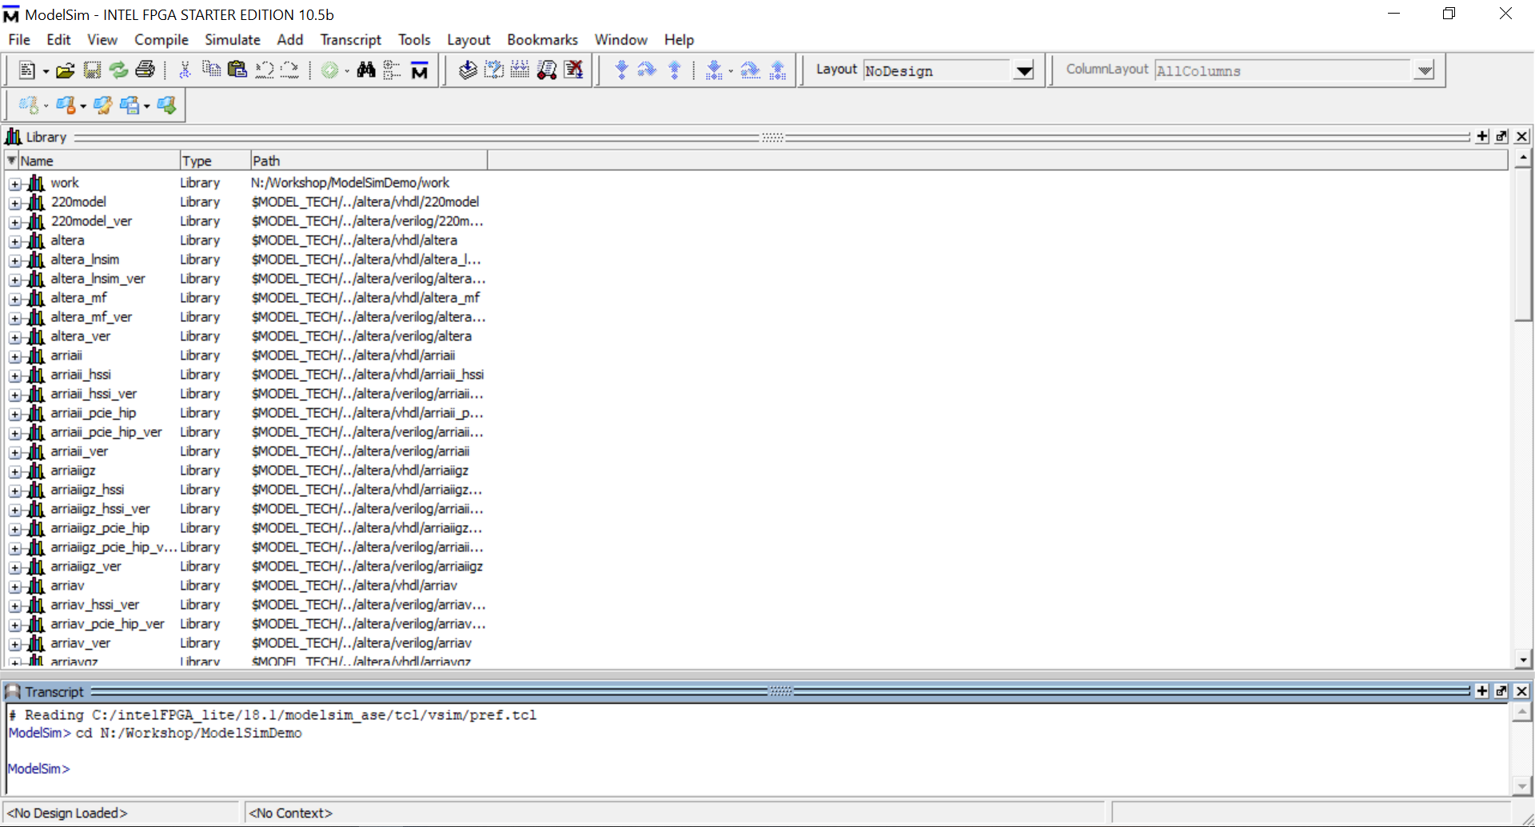

Slide 23
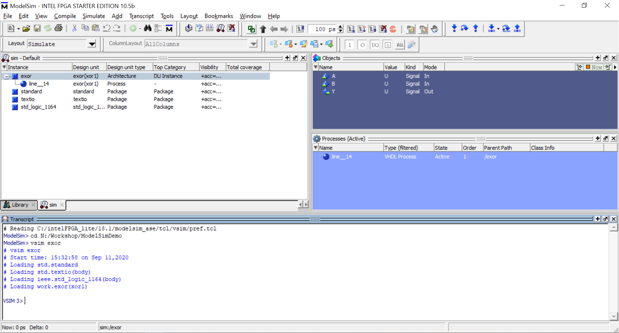

Slide 24
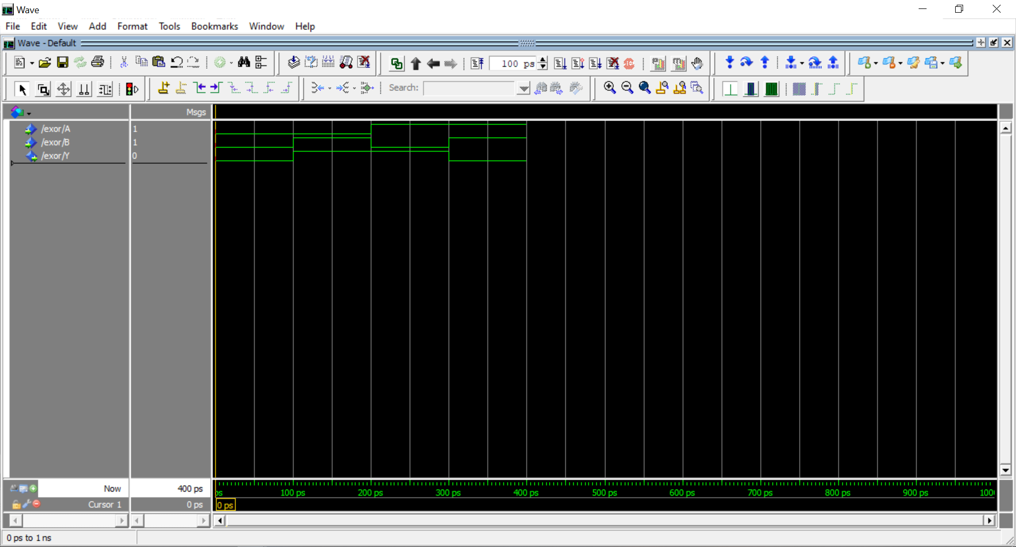

Slide 25
Resources
Github.com/niharhshah/Quartus-Workshop

Slide 26
Thank you!

